Slide 1
SPIN: Part 1
15-414/614 Bug Catching: Automated Program Verification
Sagar Chaki
April 21, 2014
Notes:
Title Slide
Title and Subtitle text blocks should not be moved from their position if at all possible.

Slide 2
What is This All About?
Spin
On-the-fly verifier developed at Bell-labs by Gerard Holzmann and others
http://spinroot.com
Promela
Modeling language for SPIN
Targeted at asynchronous systems
Switching protocols
http://spinroot.com/spin/Man/Quick.html

Slide 3
History
Work leading to Spin started in 1980
First bug found on Nov 21, 1980 by Pan
One-pass verifier for safety properties
Succeeded by
Pandora (82),
Trace (83),
SuperTrace (84),
SdlValid (88),
Spin (89)
Spin covered omega-regular properties

Slide 4
Spin Capabilities
Interactive simulation
For a particular path
For a random path
Exhaustive verification
Generate C code for verifier
Compile the verifier and execute
Returns counter-example
Lots of options for fine-tuning

Slide 5
Spin Overall Structure
GUI
Front-end
Promela
Parser
LTL Parser and
Translator
Syntax
Error
Reports
Interactive
Simulation
Verifier
Generator
Counter Example
Optimized Model
Checker (ANSI C)
Executable O-T-F
Verifier

Slide 6
Promela
Stands for Process Meta Language
Language for asynchronous programs
Dynamic process creation
Processes execute asynchronously
Communicate via shared variables and message channels
Races must be explicitly avoided
Channels can be queued or rendezvous
C like syntax

Slide 7
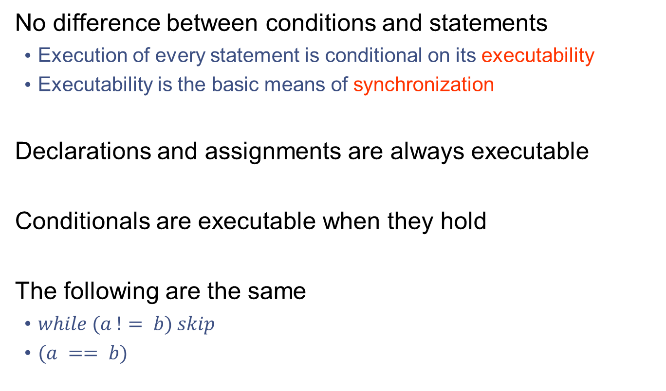
Executability
No difference between conditions and statements
Execution of every statement is conditional on its executability
Executability is the basic means of synchronization
Declarations and assignments are always executable
Conditionals are executable when they hold
The following are the same
$while (a != b) skip$
$(a == b)$

Slide 8
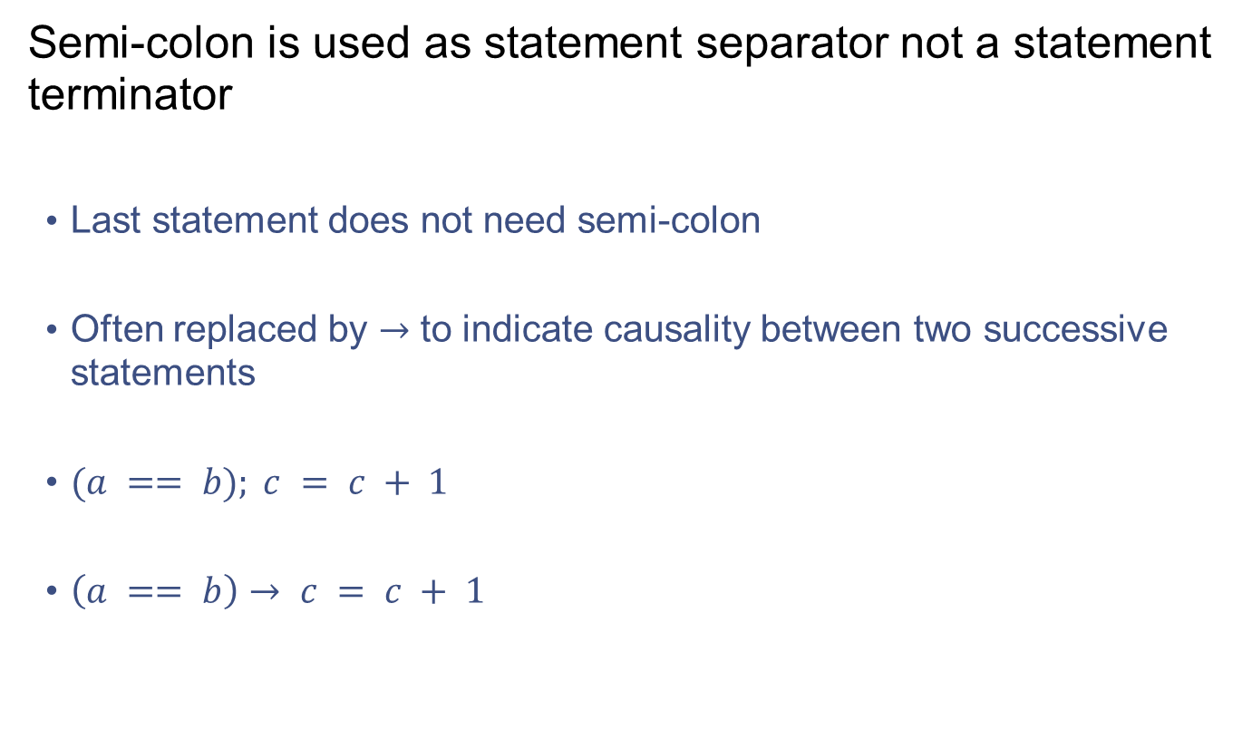
Delimitors
Semi-colon is used as statement separator not a statement terminator
Last statement does not need semi-colon
Often replaced by $→$ to indicate causality between two successive statements
$(a == b); c = c + 1$
$\left(a == b\right)→ c = c + 1$

Slide 9
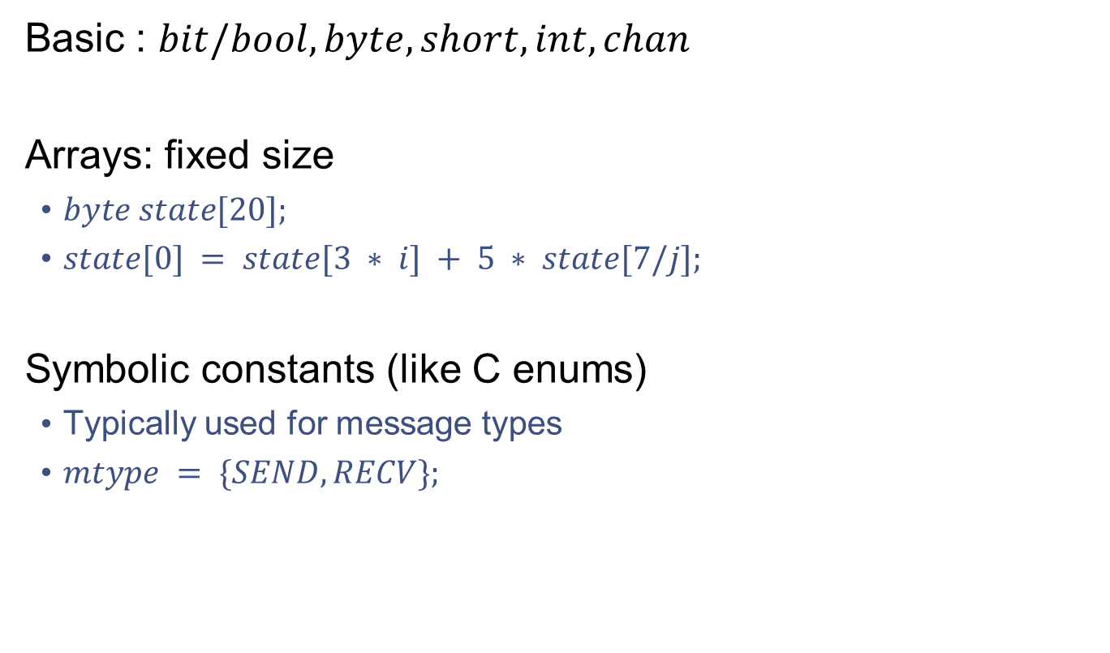
Data Types
Basic : $bit/bool, byte, short, int, chan$
Arrays: fixed size
$byte state[20];$
$state[0] = state[3 ∗ i] + 5 ∗ state[7/j];$
Symbolic constants (like C enums)
Typically used for message types
$mtype = \{SEND, RECV\};$

Slide 10
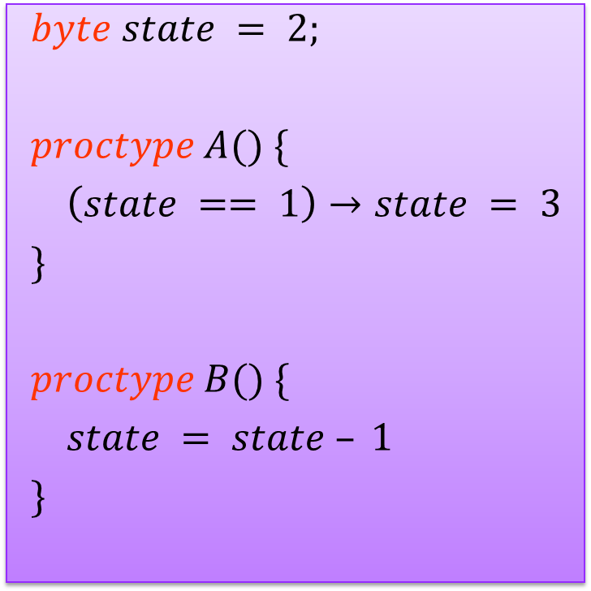
Process Definition
$$byte state = 2;$$
$$proctype A() \{$$
$$\left(state == 1\right)→state = 3$$
$$\}$$
$$proctype B() \{$$
$$state = state – 1$$
$$\}$$
Only definitions. Need a “main” function to run

Slide 11
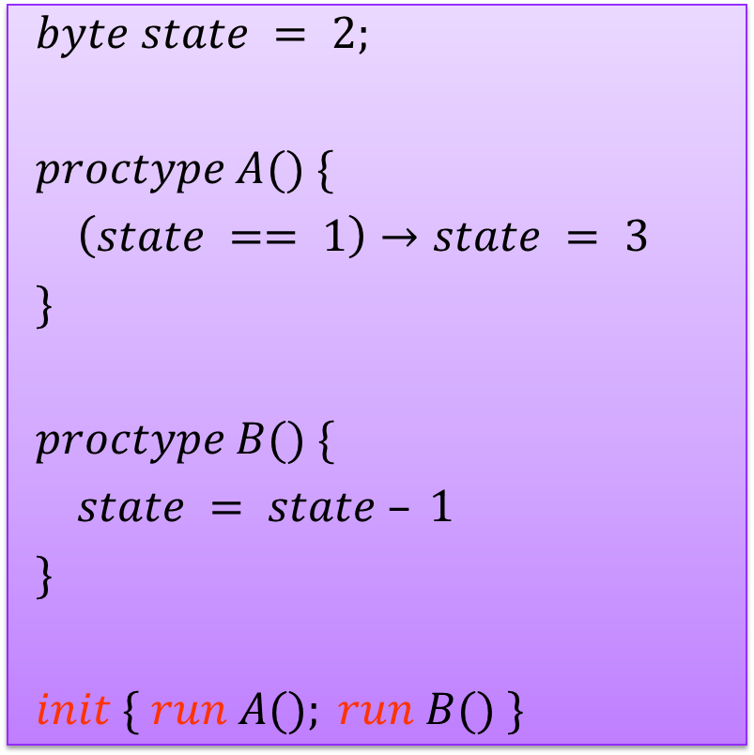
Process Instantiation
Sample 1
$$byte state = 2;$$
$$proctype A() \{$$
$$\left(state == 1\right)→state = 3$$
$$\}$$
$$proctype B() \{$$
$$state = state – 1$$
$$\}$$
$$init \{ run A(); run B() \}$$
run can be used anywhere. Dynamic Process Creation.

Slide 12
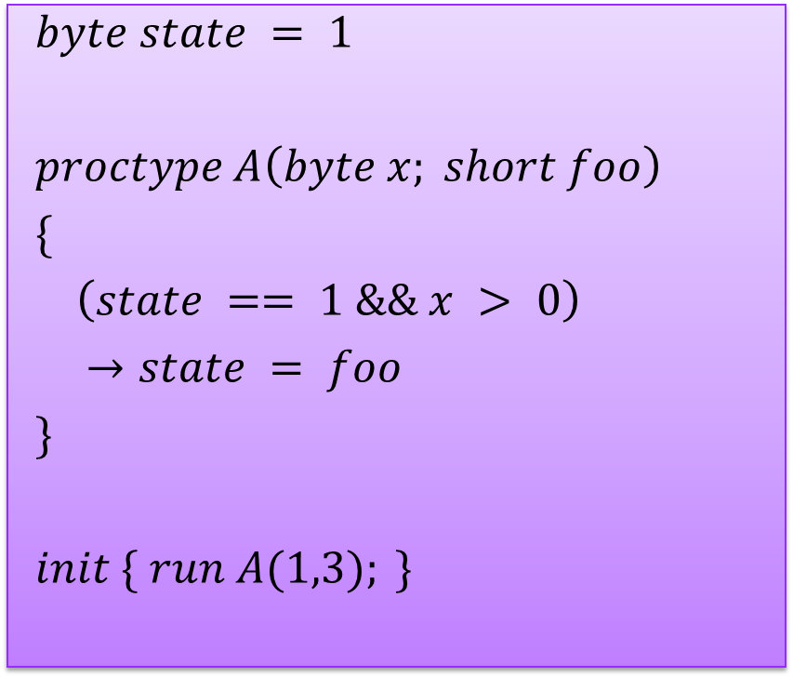
Process Parameterization
Sample 2
$$byte state = 1$$
$$proctype A\left(byte x; short foo\right)$$
$$\{$$
$$\left(state == 1 \&\& x > 0\right)$$
$→state = foo$
$$\}$$
$$init \{ run A(1,3); \}$$
Data arrays or processes cannot be passed

Slide 13
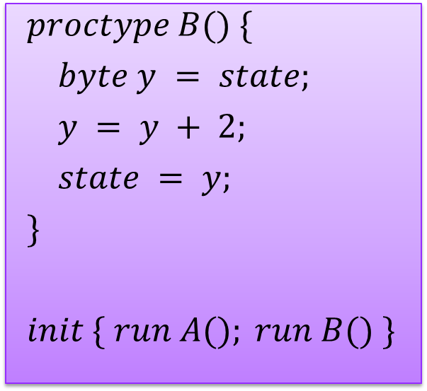
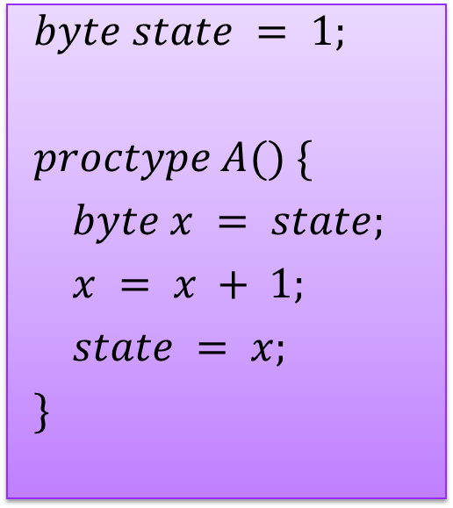
Race Condition
Sample 3
$$byte state = 1;$$
$$proctype A() \{$$
$$byte x = state;$$
$$x = x + 1;$$
$$state = x;$$
$$\}$$
$$proctype B() \{$$
$$byte y = state;$$
$$y = y + 2;$$
$$state = y;$$
$$\}$$
$$init \{ run A(); run B() \}$$

Slide 14
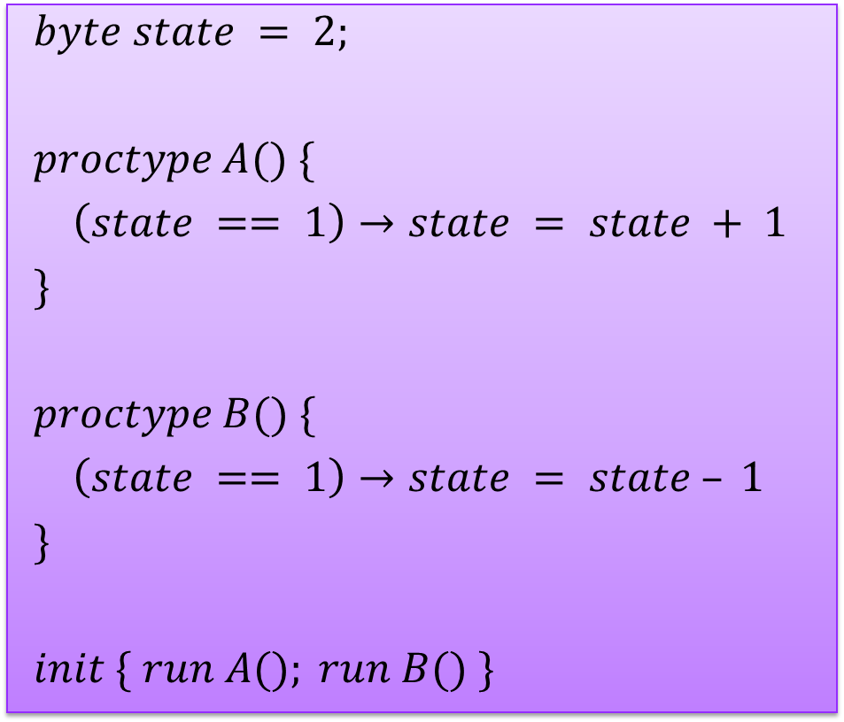
Deadlock
Sample 4
$$byte state = 2;$$
$$proctype A() \{$$
$$\left(state == 1\right)→state = state + 1$$
$$\}$$
$$proctype B() \{$$
$$\left(state == 1\right)→state = state – 1$$
$$\}$$
$$init \{ run A(); run B() \}$$

Slide 15
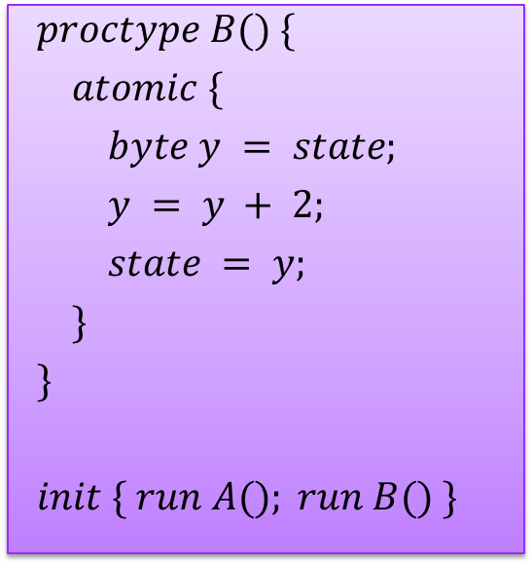
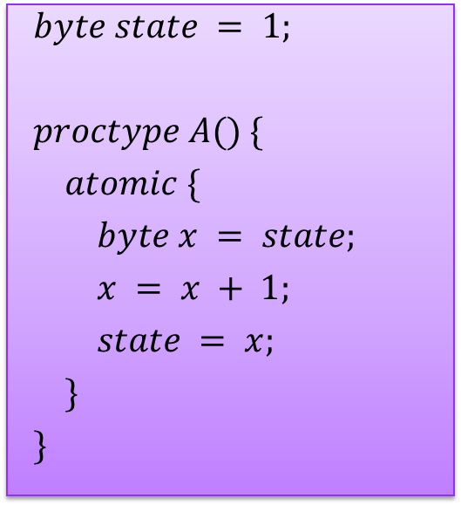
Atomic sequences
Sample 5
$$byte state = 1;$$
$$proctype A() \{$$
$$atomic \{$$
$$byte x = state;$$
$$x = x + 1;$$
$$state = x;$$
$$\}$$
$$\}$$
$$proctype B() \{$$
$$atomic \{$$
$$byte y = state;$$
$$y = y + 2;$$
$$state = y;$$
$$\}$$
$$\}$$
$$init \{ run A(); run B() \}$$

Slide 16
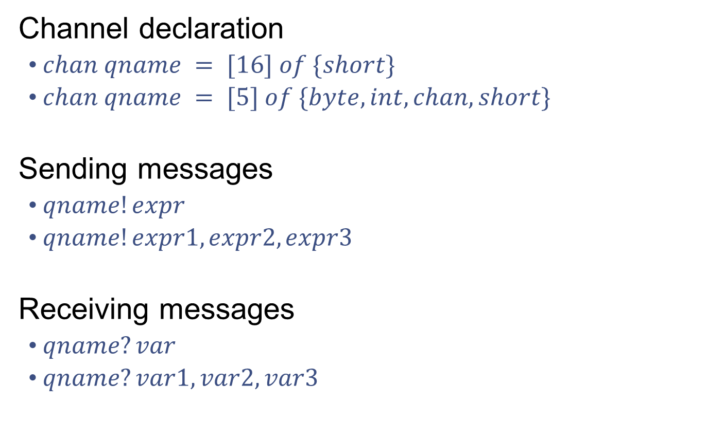
Message passing
Channel declaration
$chan qname = [16] of \{short\}$
$chan qname = [5] of \{byte,int,chan,short\}$
Sending messages
$qname!expr$
$qname!expr1,expr2,expr3$
Receiving messages
$qname?var$
$qname?var1,var2,var3$

Slide 17
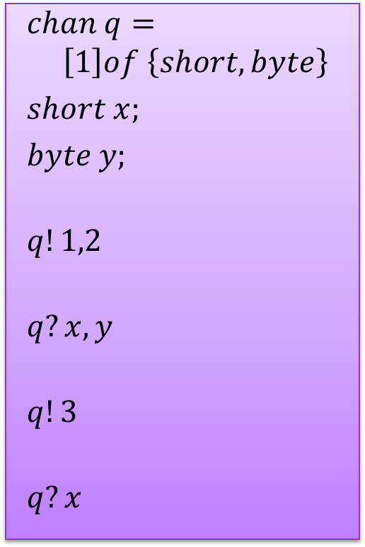
Message passing
$$chan q=$$
$\left[1\right]of \left\{short,byte\right\}$
$$short x;$$
$$byte y;$$
$$q!1,2$$
$$q?x,y$$
$$q!3$$
$$q?x$$
More parameters sent
Extra parameters dropped
More parameters received
Extra parameters undefined
Fewer parameters sent
Extra parameters undefined
Fewer parameters received
Extra parameters dropped

Slide 18
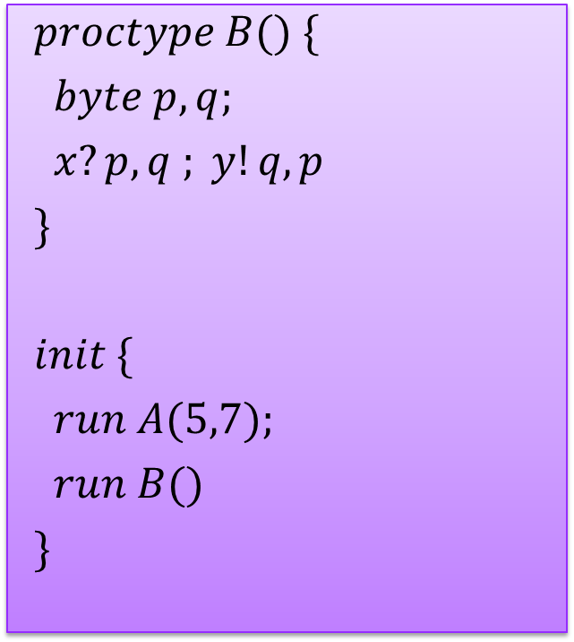
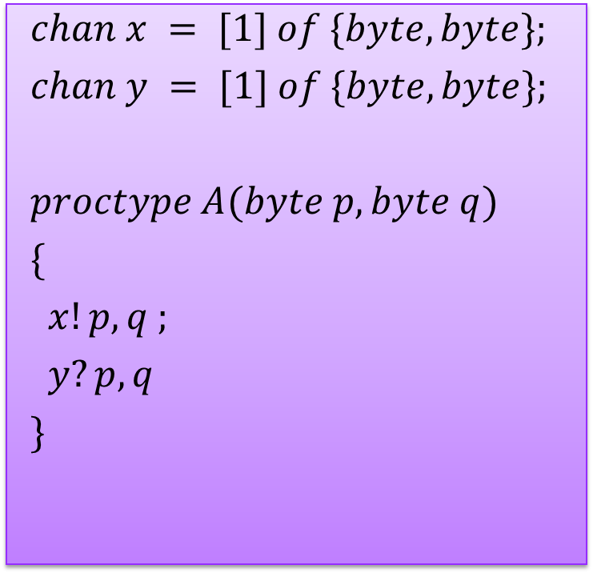
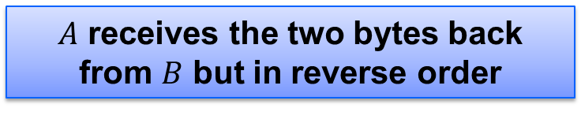
Message passing
Sample 6
$$chan x = [1] of \{byte,byte\};$$
$$chan y = [1] of \{byte,byte\};$$
$$proctype A(byte p, byte q)$$
$$\{$$
$$x!p,q ;$$
$$y?p,q$$
$$\}$$
$$proctype B() \{$$
$$byte p,q;$$
$$x?p,q ; y!q,p$$
$$\}$$
$$init \{$$
$$run A(5,7);$$
$$run B()$$
$$\}$$
$A$ receives the two bytes back from $B$ but in reverse order

Slide 19
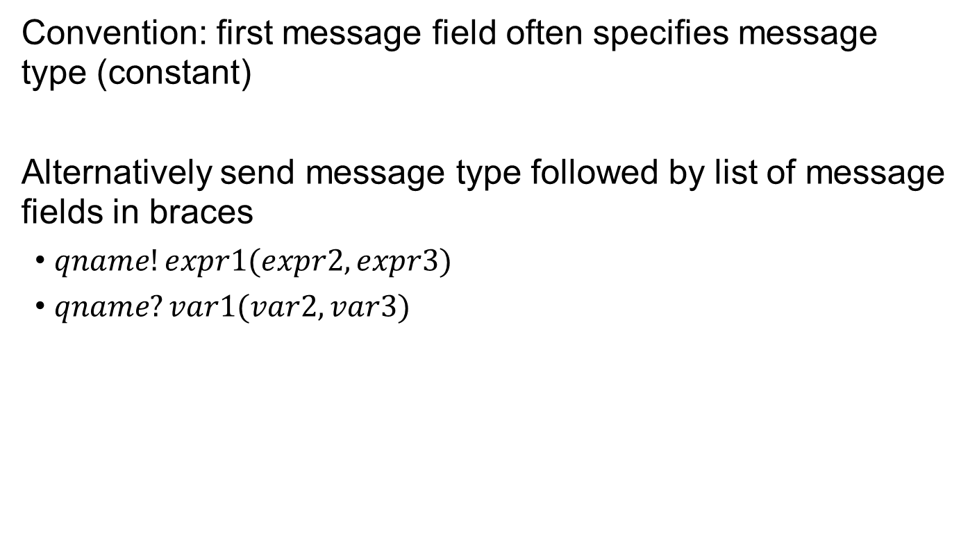
Message passing
Convention: first message field often specifies message type (constant)
Alternatively send message type followed by list of message fields in braces
$qname!expr1(expr2,expr3)$
$qname?var1(var2,var3)$

Slide 20
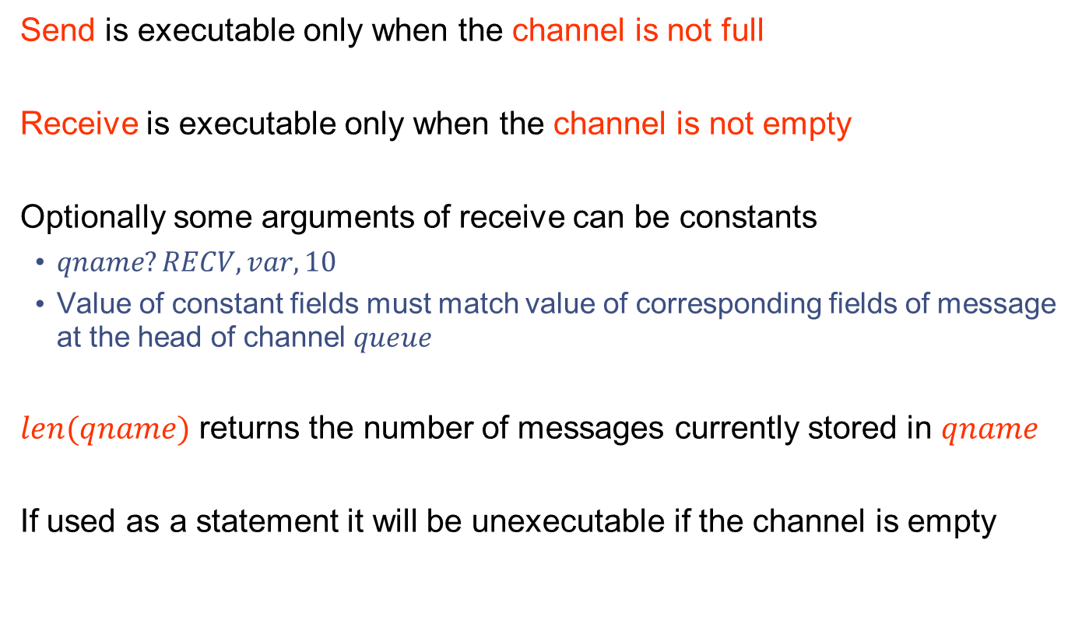
Executability
Send is executable only when the channel is not full
Receive is executable only when the channel is not empty
Optionally some arguments of receive can be constants
$qname?RECV,var,10$
Value of constant fields must match value of corresponding fields of message at the head of channel $queue$
$len(qname)$ returns the number of messages currently stored in $qname$
If used as a statement it will be unexecutable if the channel is empty

Slide 21
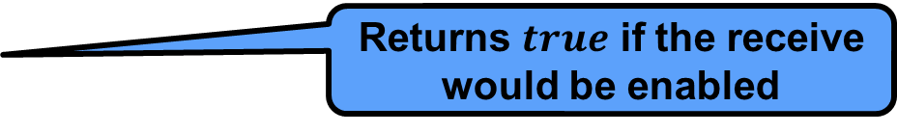
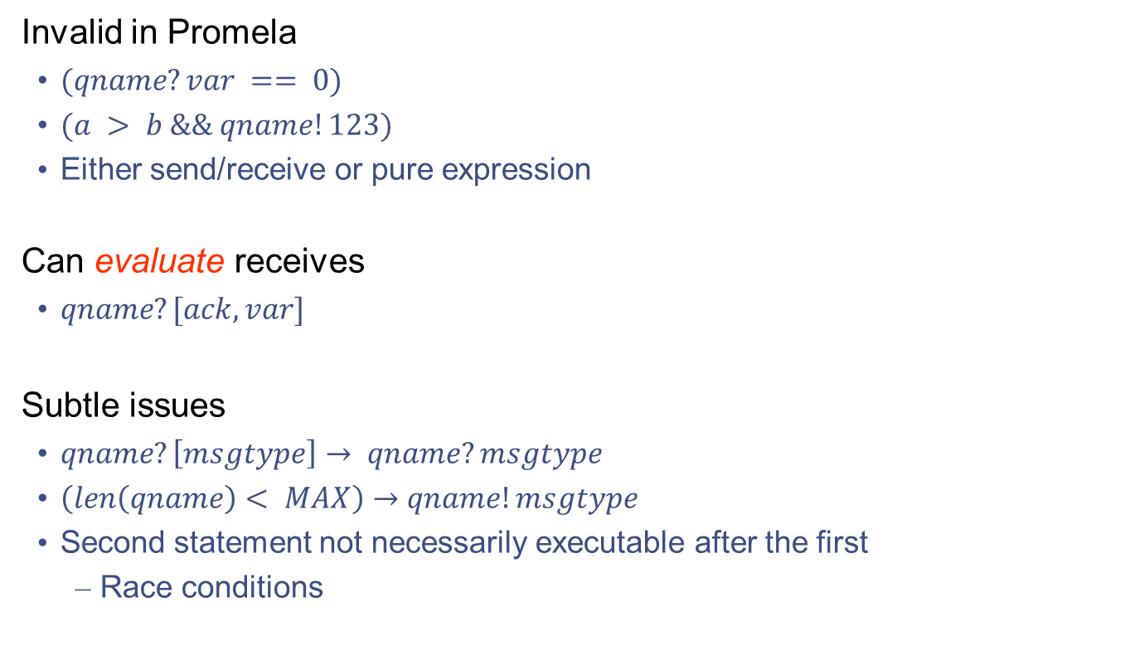
Composite conditions
Invalid in Promela
$(qname?var == 0)$
$(a > b \&\& qname!123)$
Either send/receive or pure expression
Can evaluate receives
$qname?[ack,var]$
Subtle issues
$qname?\left[msgtype\right]→ qname?msgtype$
$\left(len\left(qname\right)< MAX\right)→qname!msgtype$
Second statement not necessarily executable after the first
Race conditions
Returns $true$ if the receive would be enabled

Slide 22
Time for example 1

Slide 23
Rendezvous
Channel of size 0 defines a rendezvous port
Can be used by two processed for a synchronous handshake
No queueing
The first process blocks
Handshake occurs after the second process arrives

Slide 24

Example
Sample 7
$$\#define msgtype 33$$
$$chan name = [0] of \{byte,byte\};$$
$$proctype A() \{$$
$$name!msgtype(99);$$
$$name!msgtype(100)$$
$$\}$$
$$proctype B() \{$$
$$byte state;$$
$$name?msgtype(state)$$
$$\}$$
$$init \{ run A(); run B() \}$$

Slide 25
Control flow
We have already seen some
Concatenation of statements, parallel execution, atomic sequences
There are a few more
Case selection, repetition, unconditional jumps

Slide 26

Case selection
$$if$$
$$:: \left(a < b\right)→option1$$
$$:: \left(a > b\right)→option2$$
$$:: else→option3 /∗ optional ∗/$$
$$fi$$
Cases need not be exhaustive or mutually exclusive
Non-deterministic selection

Slide 27
Time for example 2

Slide 28
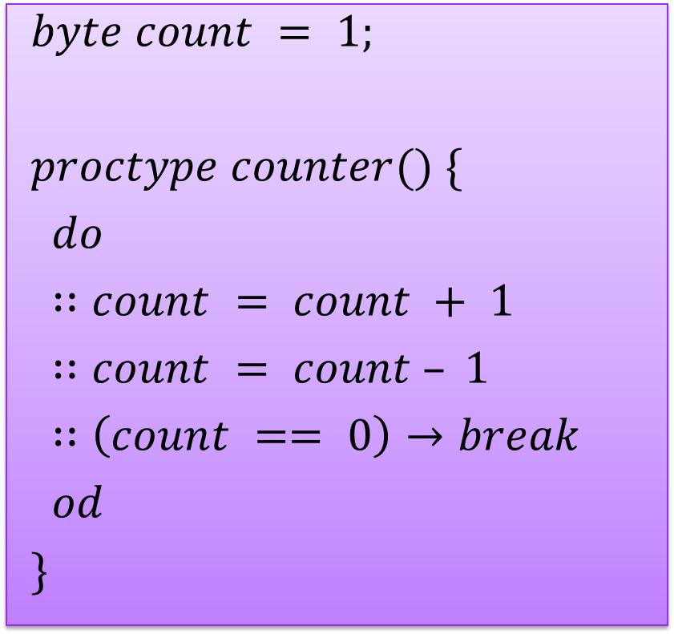
Repetition
$$byte count = 1;$$
$$proctype counter() \{$$
$$do$$
$$∷count = count + 1$$
$$∷count = count – 1$$
$$∷\left(count == 0\right)→break$$
$$od$$
$$\}$$

Slide 29
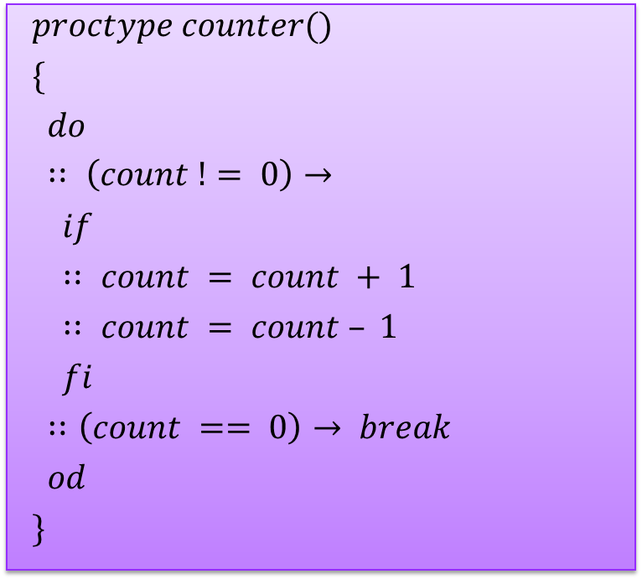
Repetition
$$proctype counter()$$
$$\{$$
$$do$$
$$∷ \left(count != 0\right)→$$
$$if$$
$$∷ count = count + 1$$
$$∷ count = count – 1$$
$$fi$$
$$∷\left(count == 0\right)→ break$$
$$od$$
$$\}$$

Slide 30
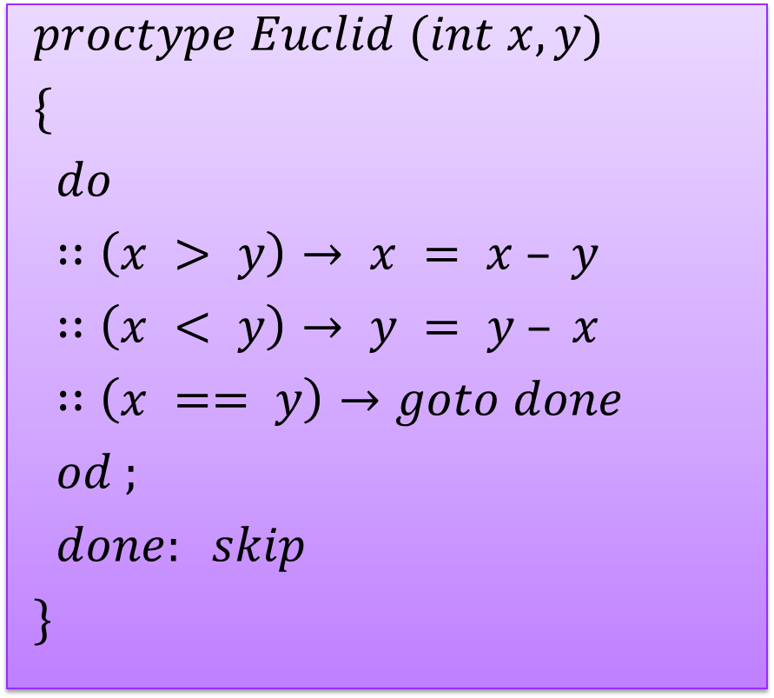
Unconditional jumps
$$proctype Euclid (int x, y)$$
$$\{$$
$$do$$
$$∷\left(x > y\right)→ x = x – y$$
$$∷\left(x < y\right)→ y = y – x$$
$$∷\left(x == y\right)→goto done$$
$$od ;$$
$$done: skip$$
$$\}$$

Slide 31
Procedures and Recursion
Procedures can be modeled as processes
Even recursive ones
Return values can be passed back to the calling process via a global variable or a message

Slide 32
Time for example 3

Slide 33
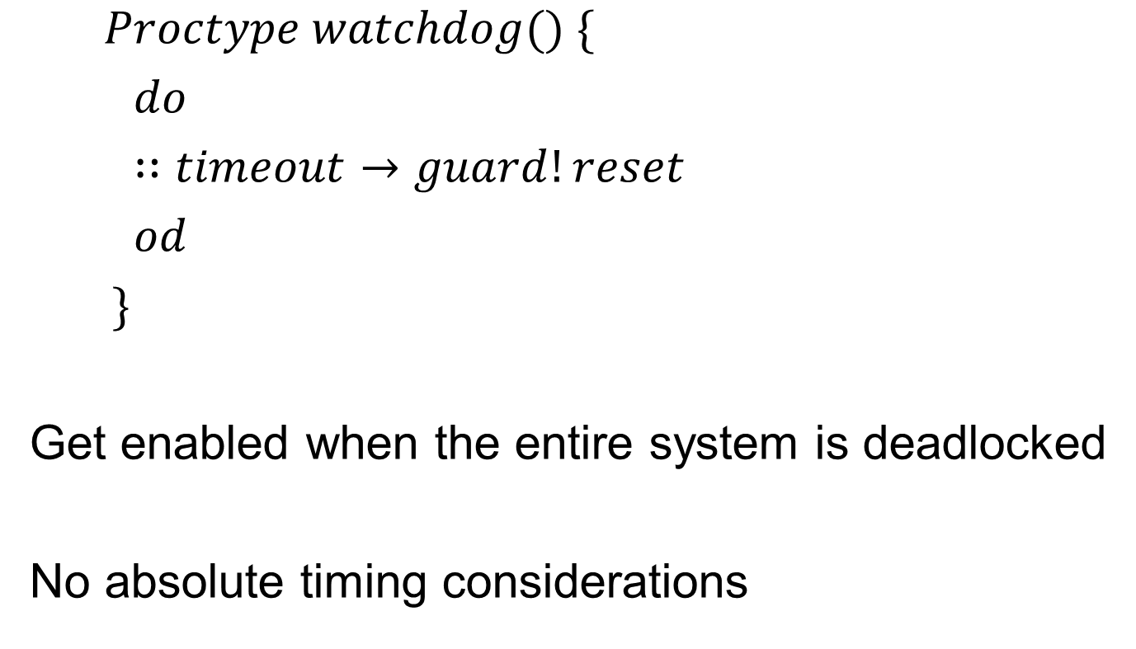
Timeouts
$$Proctype watchdog() \{$$
$$do$$
$$∷timeout→guard!reset$$
$$od$$
$$\}$$
Get enabled when the entire system is deadlocked
No absolute timing considerations

Slide 34

Assertions
$$assert(any_boolean_condition)$$
pure expression
If condition holds ) no effect
If condition does not hold ) error report during verification with Spin

Slide 35
Time for example 4

Slide 36
References
http://cm.bell-labs.com/cm/cs/what/spin/
http://cm.bell-labs.com/cm/cs/what/spin/Man/Manual.html
http://cm.bell-labs.com/cm/cs/what/spin/Man/Quick.html

Slide 37
Questions?
Sagar Chaki Senior Member of Technical Staff RTSS Program Telephone: +1 412-268-1436 Email: chaki@sei.cmu.edu | U.S. Mail Software Engineering Institute Customer Relations 4500 Fifth Avenue Pittsburgh, PA 15213-2612 USA
Web www.sei.cmu.edu/staff/chaki | Customer Relations Email: info@sei.cmu.edu Telephone: +1 412-268-5800 SEI Phone: +1 412-268-5800 SEI Fax: +1 412-268-6257

